Slide 1
Designing and Building Social Ventures
Module 2

Slide 2
@ID: Headings would be OST throughout.
Module 2 Duration Designing and Building Social Ventures [Mention no. of hours]
Have you ever wondered how the world would be, if every child is hunger-free and happy?
It would be the best place to live in, right? But for such things to happen, we need:
Brave ideas, well-designed development models, and action-oriented leaders.
A social venture that is empathetic, impactful and inclusive.
https://www.freepik.com/premium-video/young-girl-smiles-happily-with-her-friends_3474893#fromView=search&page=1&position=7&uuid=7b6c4fef-8d98-4669-900f-25ac4bbc0231
Alt text: A young girl smiling
Notes:
VO (at the start of the slide): Welcome to Module 2: Designing and Building Social Ventures

Slide 3
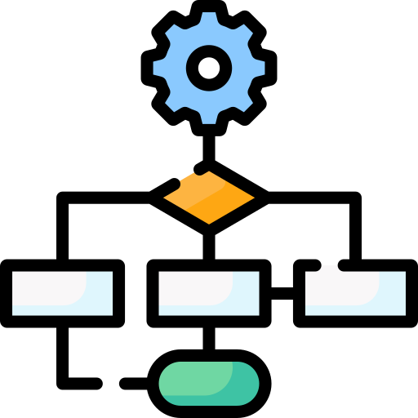

Module Outline
This Module comprises these units:
https://www.flaticon.com/free-icon/workflow_6159792?term=business+model&page=1&position=50&origin=search&related_id=6159792
https://www.flaticon.com/free-icon/accounting_9428409?term=financial+planning&page=1&position=44&origin=search&related_id=9428409
Unit 2.1
Social Business Model
2.1.1: Introduction to Business Model Canvas (BMC)
2.1.2: Mission Alignment
2.1.3: Lean Startup and Early-Stage Validation
2.1.4: Models for Social Impact and Scale
Unit 2.2
Financial Planning and Resource Mobilisation
2.2.1: Revenue Models for Social Enterprises
2.2.2: Fundraising Strategies
2.2.3: Basics of Budgeting and Costing
2.2.4: Innovative Finance Models
Click on each icon to know more!

Slide 4

Unit 2.1: Business Model Development
Key Learning Outcomes
At the end of this Unit, you should be able to:
Describe the components of a Social Business Model Canvas and its applications to mission-driven ventures.
Explain how social enterprises integrate social, environmental, and financial goals into their core strategy.
Explain the principles of the lean startup method and how they support early-stage experimentation.
Analyse different social enterprise delivery models and evaluate their effectiveness in scaling impact across diverse contexts.
Develop a minimum viable product (MVP) and plan a basic user testing strategy.
Notes:
VO (as the heading appears) Unit 2.1: Business Model Development. And here are the key learning outcomes.

Slide 5
Business Model Development
Meet Ravi, a rural innovation field officer. He has been asked to improve access to education in a flood-prone village. He knows that during monsoons, the area stays flooded, and schools remain shut for weeks.
Ravi thinks, what if we could have floating schools during floods?
This is what business model development is all about: you identify a challenge, understand the context, and design a solution that works, sustainably.
Houseboat Animated Icon - Free Download Buildings Animated Icons | IconScout
Alt text: Houseboat icon
Notes:
VO as the heading appears: Let us begin with understanding what business model development is.

Slide 6

@ID: Headings would be OST throughout.
2.1.1: Introduction to Business Model Canvas (BMC)
Imagine you are building a treehouse, not just for fun, but to offer a reading corner for kids in your community. To get started, you need a clear blueprint:
What kind of wood to use?
Which part of the tree should it be on?
Who will help build it?
And most importantly, why are you building it?
https://www.freepik.com/free-vector/tree-house-concept-illustration_25182818.htm#fromView=search&page=3&position=25&uuid=f28bc687-c59d-4e56-9ef6-a5ade1f2d6af&query=building+a+treehouse+
Alt text: A treehouse
Notes:
VO as the heading appears: Let’s understand Business Model Canvas in more detail.

Slide 7

In continuation with the previous slide.
@ID: Please don’t give VO for the heading
Introduction to Business Model Canvas (BMC)
Planet
People
In the same way, the Business Model Canvas (BMC) is a blueprint for your social startup.
It is a one-page strategic tool that helps you plan, build, and communicate how your venture will create, deliver, and capture value; not just for profit, but for people and the planet.
Profit
Alt text: Profit, people and planet concept
https://www.freepik.com/premium-vector/environment-ecology-protection-concept-woman-take-care-earth-planet-environmental-nature_41770371.htm#fromView=search&page=1&position=32&uuid=f598a63e-d4f7-445e-bf81-08a60aa27d16&query=profit+people+and+planet+illustration

Slide 8
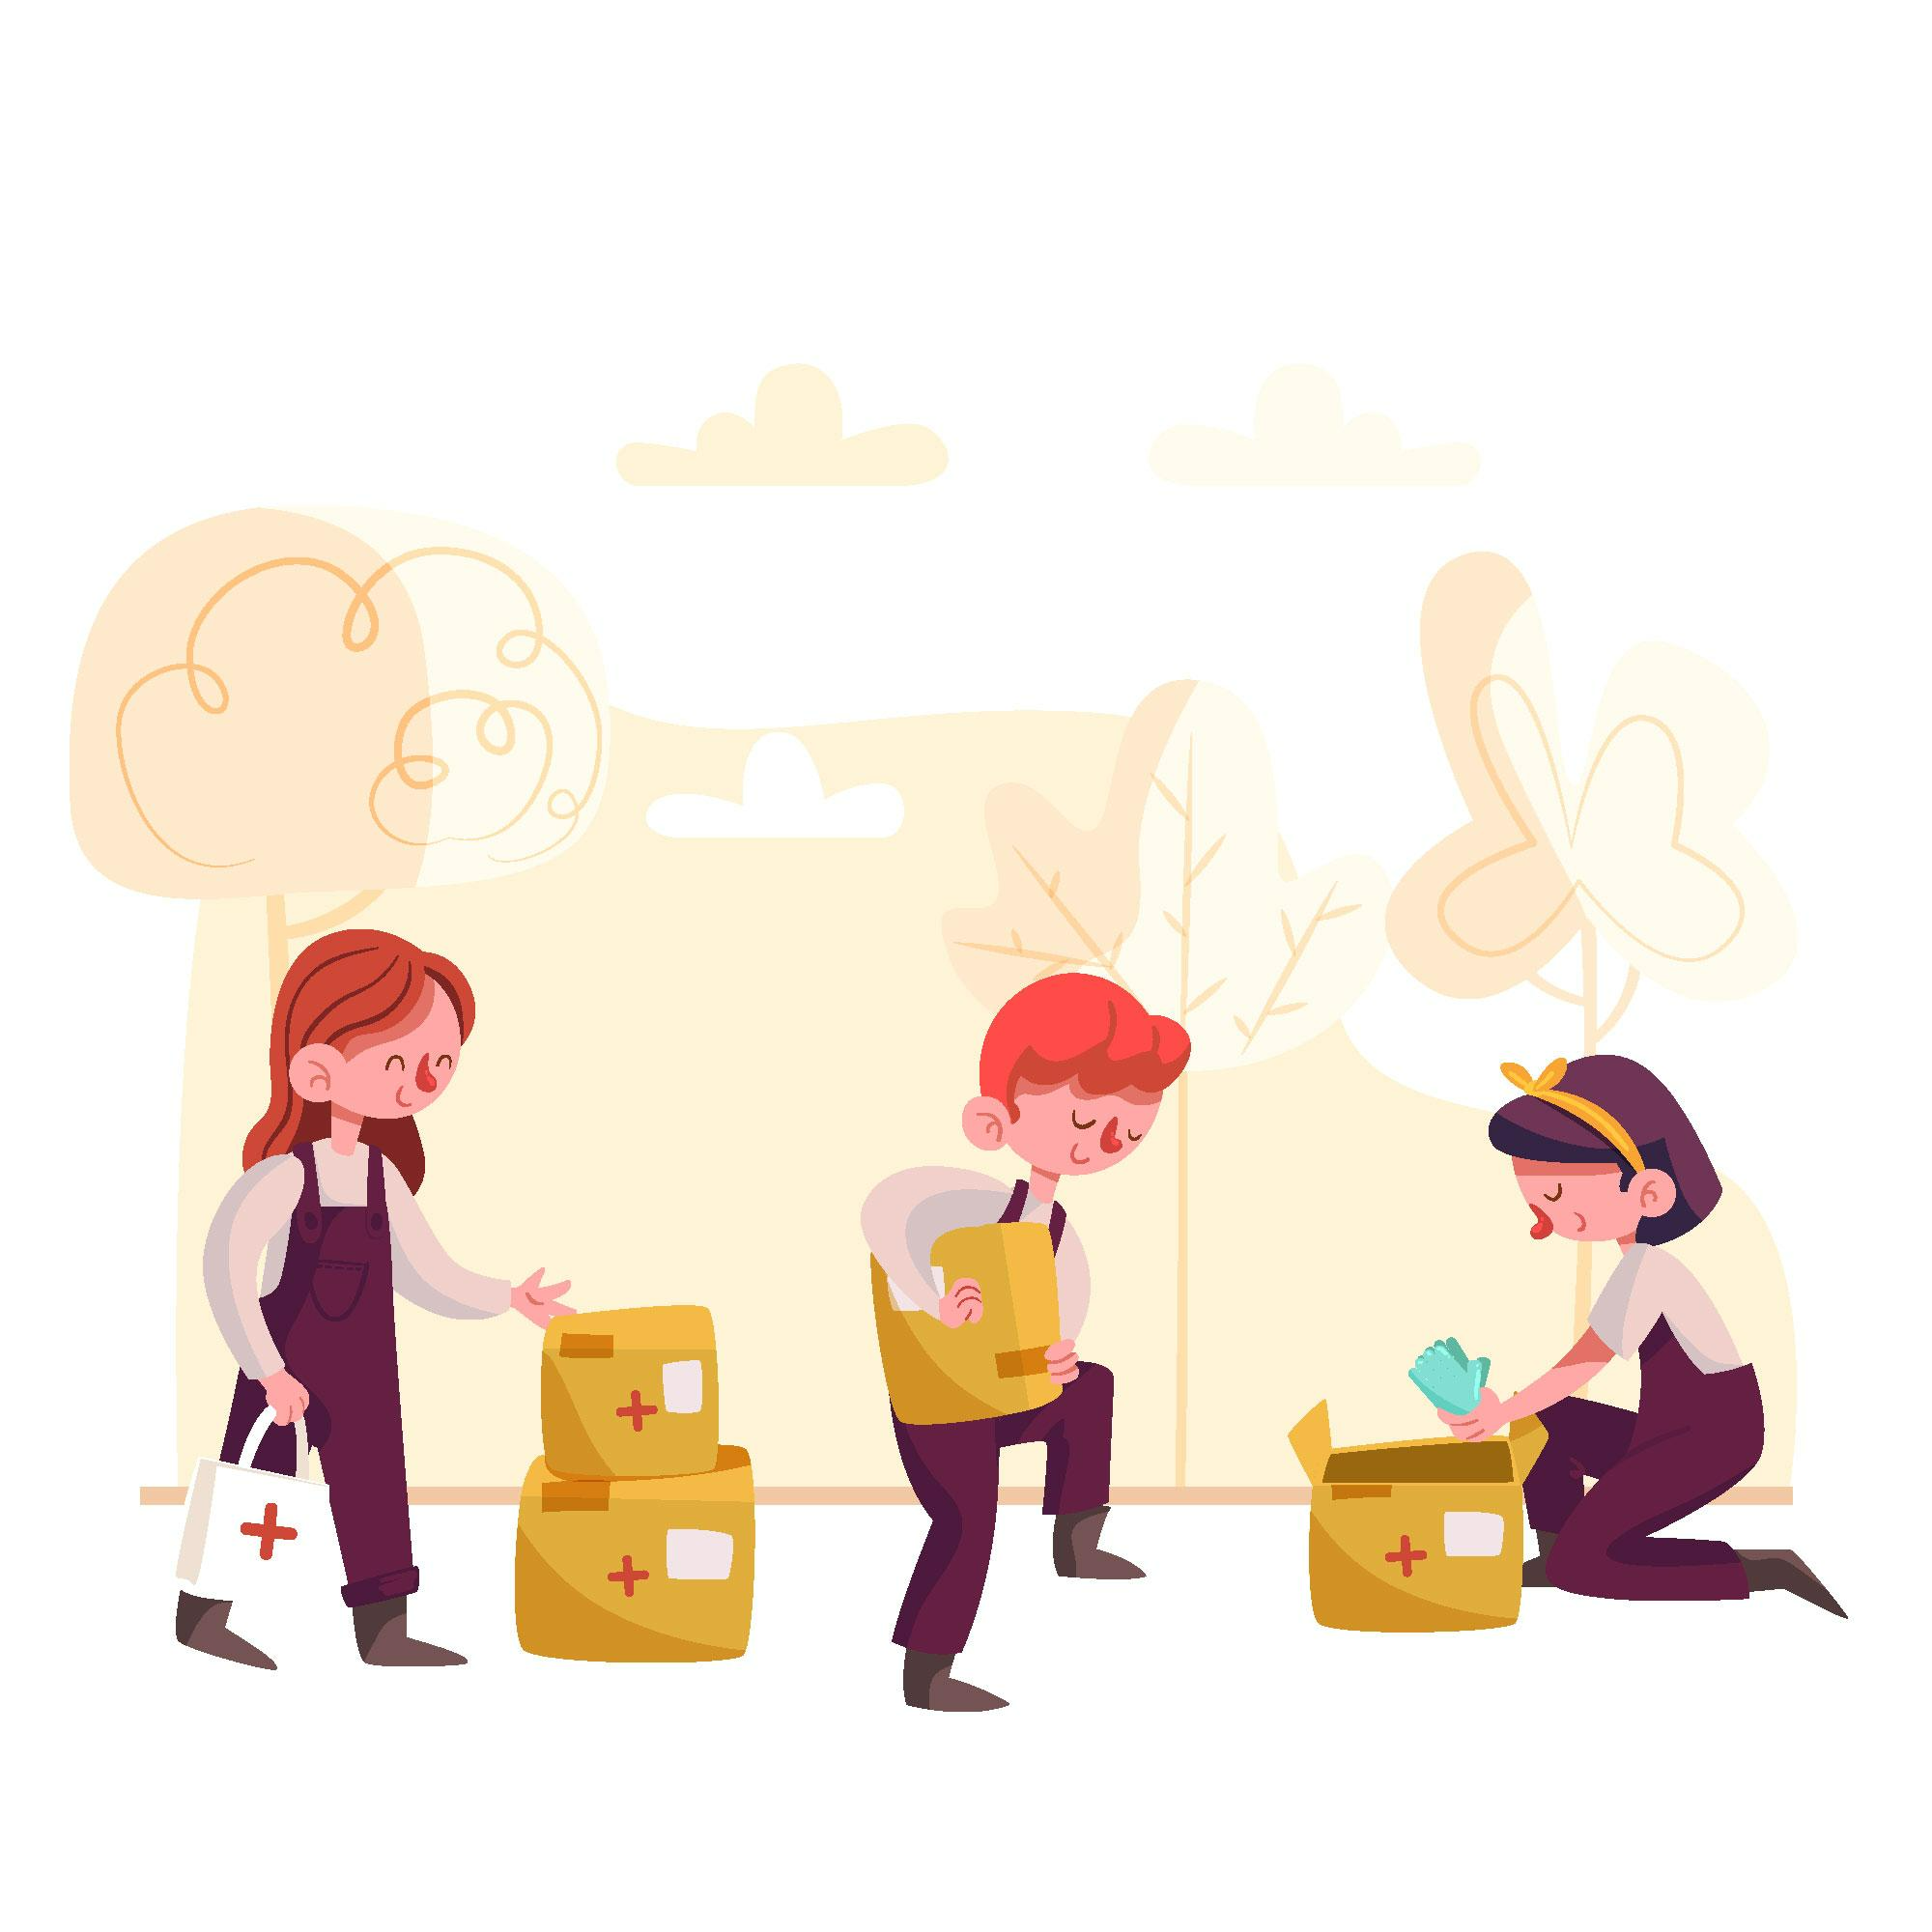
What is a Social Startup?
A social startup is a venture that uses entrepreneurial tools to solve social or environmental problems.
Unlike traditional businesses where profit is the primary goal, social startups are driven by purpose.
Profit may support the mission, but it is not the core reason they exist.
Alt text: Volunteers with medical supplies
https://www.freepik.com/free-vector/people-donating-sanitary-material-those-need_7881412.htm#fromView=search&page=1&position=15&uuid=b76fc605-5839-4b84-9622-5a422f7fb64e&query=social+issues+education%2C+hunger

Slide 9
Components of Business Model Canvas
The Business Model Canvas consists of nine interdependent building blocks. Together, these define how your startup works—from the people you serve, to how you reach them, to how you sustain your impact.
These nine blocks are grouped into four foundational sections, each answering a critical question: Only VO: The Why and for whom, The how, The with what, and the sustainability lens.
Customer Relationships
@designer: Please create a better image, this is just for representation purposes how the image should look.
Channels
Value Proposition
Key Partnerships
Cost Structure
Customer Segments
Key Activities
Key Resources
Revenue Streams
The 'Why' and 'For Whom'
The 'How'
The 'With What'
The 'Sustainability Lens'
Embed ppt (pdf) Components of Business Model Canvas here
Notes:
VO as the heading appears: What are the core components of BMC?
VO (at the end): Click next to learn about each pointer in some detail.

Slide 10
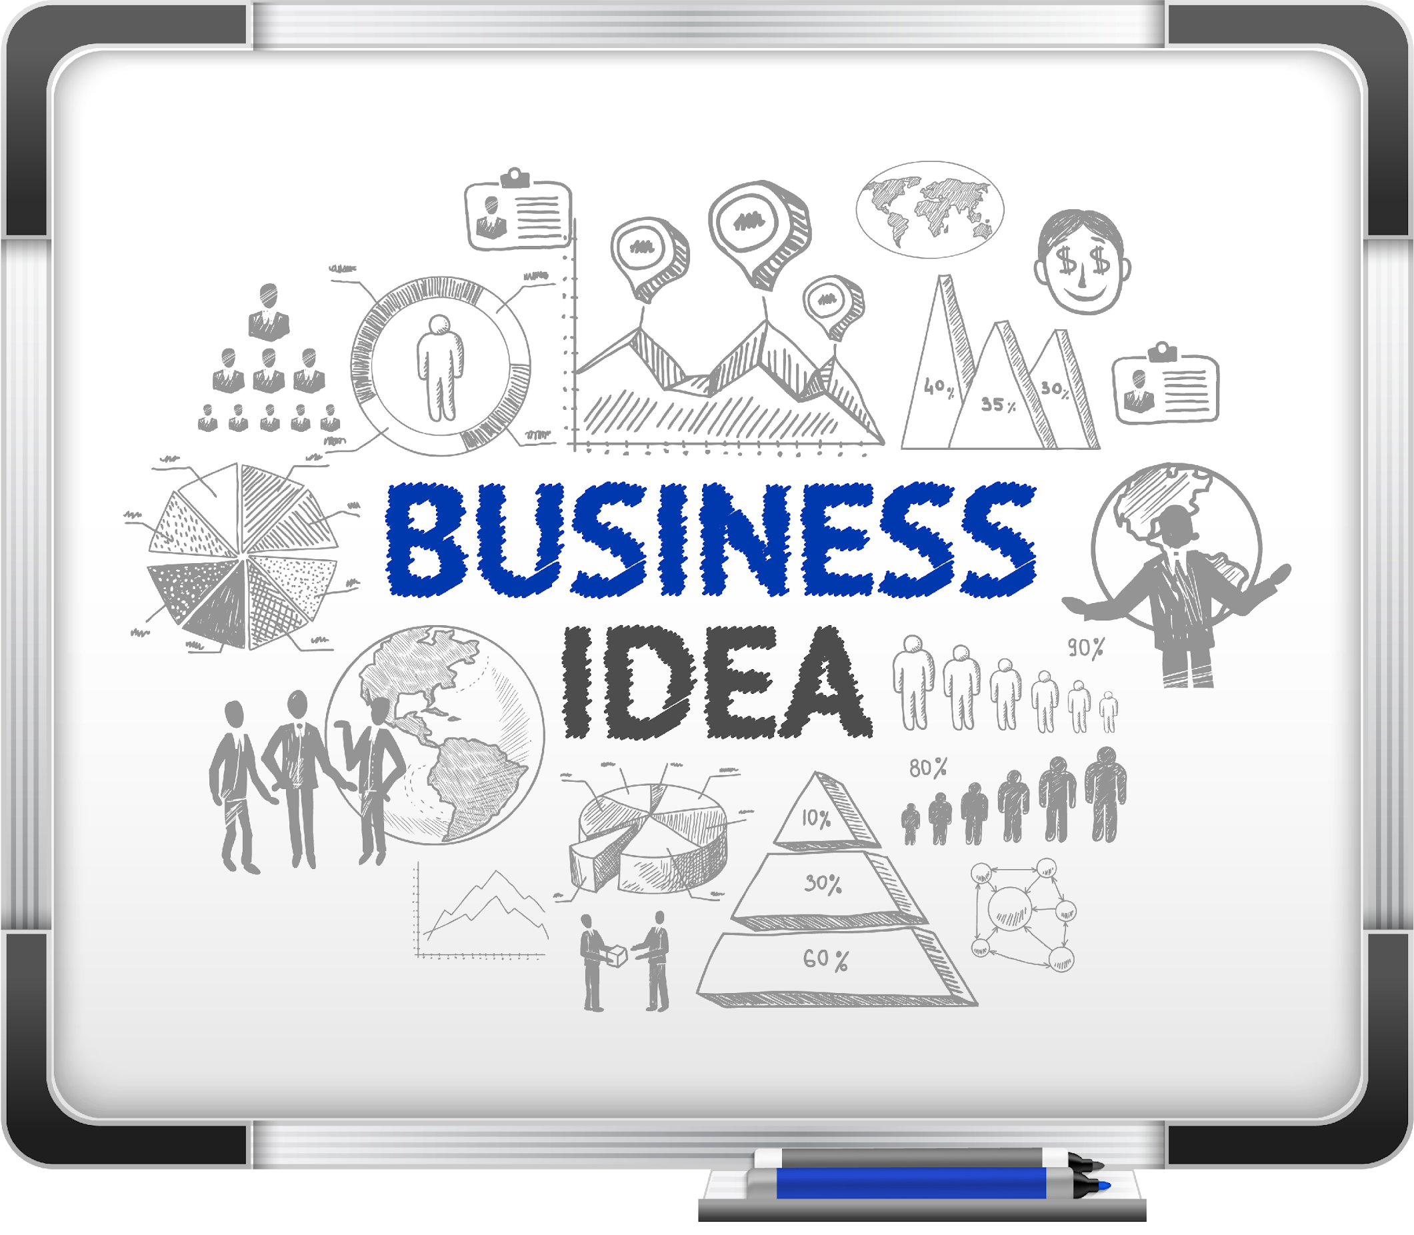
@designer: Please try to use the template provided on slide #15 in the video.
Example
How do you bring a social business model canvas into action?
Alt text: Business idea canvas
Embed as a Slideshow video ‘Business Model Canvas in Action’ here.
Notes:
VO as the heading appears: Let us understand this with the help of an example.
VO (at the end): Click next to watch a video.

Slide 11
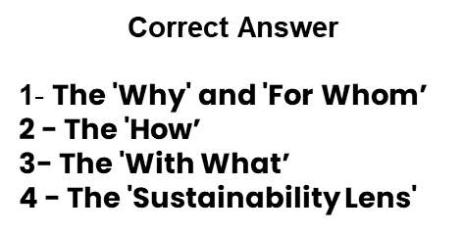
@ID: Please jumble the foundational model (boxes)
Think Break!
Here is a scenario with four statements that represent a part of a business model and the foundational blocks. Drag and drop each block to match the statement.
1. Riya wants to start a small mobile library van that travels to underprivileged locations in urban areas.
2. She plans to collaborate with local schools and volunteers who can conduct reading sessions and manage the mobile unit.
3. The initial setup includes a second-hand van and donated books from individuals and NGOs.
4. She decides to use solar-powered batteries for the van to keep fuel costs low and reduce environmental impact.
The 'How'
The 'Sustainability Lens'
The 'Why' and 'For Whom’
The 'With What'
Notes:
VO as the heading appears: Reflect on your learning so far.

Slide 12
@ID: Share one para at a time
Business Mission Animation - Free Download Business Animations | IconScout
2.1.2: Mission Alignment
Alt text: Aligning mission to the business model.
Mission alignment means making sure the core purpose of a social enterprise, is part of everything the venture does, its business model design, operations, partnerships, and growth strategy.
Without this, even well-meaning ventures can face mission drift, reducing their impact or slipping into conventional for-profit models.
That’s why mission lock-in mechanisms and double/triple bottom line thinking are essential. They not only protect the mission but also help measure success in a holistic, purpose-driven way.
4
1
Growth strategy
Business model design
Partnerships
Operations
3
2
Embed the PDF as a Video ‘Drifting from the Mission’ here
Notes:
VO as the heading appears: Let us now learn about mission alignment.
VO at the end: Click next to watch a video to understand why a mission drifts.

Slide 13

Mission Lock-In
Mission lock-in ensures the venture’s purpose is deeply built into its legal framework, daily operations, and long-term plans.
This ensures the mission stays strongly aligned and cannot be easily changed or weakened, even when outside forces push for different priorities.
Legal Framework
Operations
Long-term Plans
Alt text: A lock
https://www.freepik.com/free-vector/security_4870958.htm#fromView=search&page=1&position=4&uuid=d0d9e1c4-ac27-43dc-aea9-0ad36d84756a&query=lock
Notes:
VO as the heading appears: So, what is mission lock-in? Let’s explore.

Slide 14



@ID: Use click and reveal
Designing Mission Lock-In
Choosing legal forms like Benefit Corporations (B-Corps) or Section 8 companies (in India) that require social impact reporting and mandate the inclusion of purpose alongside profit.
Appointing board members or advisory councils with mission-focused oversight. In some cases, ventures even reserve “mission veto rights” for specific stakeholders to safeguard social outcomes.
Drafting organisational charters that prioritise mission fulfilment and codify this in decision-making protocols, performance metrics, and hiring processes.
Legal Structures
Governance Mechanisms
Charter and Values Integration
https://www.flaticon.com/free-icon/legal_18379151?term=legal+structures&page=1&position=6&origin=search&related_id=18379151
https://www.flaticon.com/free-icon/checks_15188093?term=governance+mechanism&page=1&position=12&origin=search&related_id=15188093
https://www.flaticon.com/free-icon/customer_10729125?term=values&page=1&position=12&origin=search&related_id=10729125
In short, mission lock-in is about anticipating drift and designing immunity against it, not just with intent, but through structure.
@ID: This box will appear at the end
Notes:
VO as the heading appears: Designing a mission lock-in involves the following. - legal structures, governance mechanisms, charter and values integration. Click on each tab to learn what each entails.

Slide 15

@ID: Remove the numberings. Dialogues will appear one by one and then disappear.
Double and Triple Bottom Lines
2. They need expanded ways of measuring success, such as the Double Bottom Line and Triple Bottom Line.
1. To ensure the mission stays truly embedded, what do social entrepreneurs need?
4. Click next to find out.
3. But what are they?
Alt text: Two people having a conversation
https://www.freepik.com/free-vector/flat-design-coworking-illustration_40485299.htm#fromView=search&page=1&position=39&uuid=4952818a-3bab-4eb2-bba8-16935b12d9dd&query=two+people+discussing+
Notes:
VO as the heading appears: After mission lock-in, what is the next step in mission alignment? Listen to this conversation!

Slide 16


@ID: Text marked as yellow is OST.
@ID: Slides # 20 and 21 are layers for this main slide.
Remove the background of the images.
Double and Triple Bottom Lines
These are the frameworks that evaluate impact beyond financial returns, providing a clearer perspective on value creation.
Alt text: Ethics scale in balance
Alt text: Focusing on the planet with different lens
https://www.freepik.com/free-vector/business-ethics-scale-balance_10980285.htm#fromView=image_search_similar&page=1&position=15&uuid=df564e87-da53-45e2-98ce-60ed9002900e&query=double+bottom+line
Businessman Searching Global Investment Opportunity At Globe Illustration - Free Download Business Illustrations | IconScout
Double Bottom Line (DBL)
Triple Bottom Line (TBL)
Click on each tab!
Notes:
VO as the heading appears: So, what are the double and triple bottom lines?
VO after the para: Click on each tab to learn more!

Slide 17
@ID: No VO
Double Bottom Line
This is a framework where a business does not just ask: “Are we making money?”
It also asks: “Are we making a difference?”
Profit
So, success is measured on two parallel tracks:
People
Financial Performance (Profit)
Social Impact (People)
Revenue, profitability, long-term sustainability, and market growth
Improvement in lives, systems-level change, reduction in inequality
Double Bottom Line

Slide 18
@ID: No VO
Triple Bottom Line
This includes environmental impact alongside financial and social goals.
It pushes businesses to ask:
Are we profitable?
Are we improving lives?
Are we reducing our ecological footprint?
Profit
People
So, success is measured on three parallel tracks:
Financial Performance (Profit)
Social Impact (People)
Environmental Impact (Planet)
Planet
Revenue, profitability, long-term sustainability, and market growth
Improvement in lives, systems-level change, reduction in inequality
Sustainability, conservation, reduced footprint
Triple Bottom Line

Slide 19


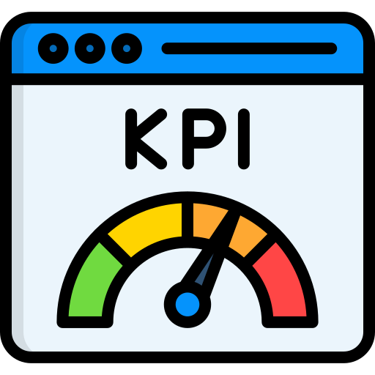

How to Measure Them?
Social entrepreneurs often use impact metrics and frameworks, such as:
https://www.flaticon.com/free-icon/generous_2871610?term=charity&page=1&position=8&origin=search&related_id=2871610
Key Performance Indicators (KPIs): e.g., lives touched, tons recycled
Social Return on Investment (SROI): How much is the impact per Rupee spent?
The B Impact Assessment: A standard for measuring Double Bottom Line (DBL) and Triple Bottom Line (TBL) values
https://www.flaticon.com/free-icon/satisfaction_1312304?term=assessment&page=1&position=13&origin=search&related_id=1312304
https://www.flaticon.com/free-icon/kpi_12313491?term=kpi&page=1&position=35&origin=search&related_id=12313491
Impact Reports: Published yearly, tracking all the bottom lines
https://www.flaticon.com/free-icon/monitor_2782163?term=report&page=1&position=20&origin=search&related_id=2782163
Embed the PDF ‘Measure Double and Triple Bottom Line’ here
Notes:
VO as the heading appears: But the big question is how to measure double and triple bottom lines?
VO after the 4 points: Click on the button to learn how to measure double and triple bottom lines.

Slide 20
@ID: The steps will appear one by one with arrow animation.
Steps to Align a Mission
Imagine a social venture wants to bring affordable solar energy to villages. Here is what the venture will do to ensure alignment:
Design its business model to offer low-cost financing and local repair services.
Build operations that hire and train people from the community.
Form partnerships with microfinance institutions and NGOs.
Plan growth strategies that expand impact without cutting corners on quality or purpose.
Use mission lock-in through legal status and impact-focused leadership.
Measure success through a triple bottom line—energy access (people), revenue (profit), and carbon savings (planet).
Notes:
VO as the heading appears: To learn to align a mission, consider this example:
VO at the end: This is how mission alignment becomes real.

Slide 21
@ID: Drag and Drop or match
Please jumble them, for your understanding, I have colour-coded them similarly.
For incorrect: “Try Again”
For correct: “You earned your Puzzle piece. Congratulations!”
Think Break!
Drag to match the correct description with the right concept.
A handicraft enterprise begins outsourcing cheap factory-made goods to boost margins, sidelining artisan producers.
Mission Lock-In
A social venture registers as a B-Corp and includes impact-focused advisors on its board to prevent mission drift.
Double Bottom Line (DBL)
Triple Bottom Line (TBL)
A microfinance startup tracks both revenue and % of women entrepreneurs supported.
Mission Drift
A biodegradable packaging company reports profits, local jobs created, and tons of plastic waste reduced.
Notes:
VO as the heading appears: Reflect on your learning so far.

Slide 22
@ID: Headings would be OST throughout.
2.1.3: Lean Startup and Early-Stage Validation
https://www.freepik.com/premium-vector/startup-new-business-concept-background-open-box-rocket-takes-off-vector-illustration_405371703.htm#fromView=search&page=1&position=38&uuid=94a90b16-a994-4c86-a000-36b3f7cacda7&query=la
Coming up with a startup idea is often the easiest part. The real challenge lies in transforming that idea into something people genuinely want, and will pay for.
That is why testing your assumptions through real customer feedback is key to proving your idea’s viability.
Alt text: Launching a startup
Notes:
VO (as the heading appears): Let us move on to the next section: Lean Startup and Early-Stage Validation
VO at the end: Click next to learn more!

Slide 23
Lean Startup and Early-Stage Validation
Lean Startup is a method for developing businesses through rapid experimentation, continuous feedback, and iterative product releases.
https://www.freepik.com/free-vector/hand-drawn-business-strategy-concept_19913424.htm#fromView=search&page=1&position=1&uuid=67f72823-0e0d-4e4a-8485-a17d9d8b03f4&query=lean+startup
Alt text: A man visualising the startup goal
Only VO: While…
Early-stage validation is a key part of the lean startup approach. It involves testing core assumptions with real users early on to confirm genuine demand, before investing heavily in building the solution.
https://www.freepik.com/premium-vector/e-learning-flat-vector-illustration_20349837.htm#fromView=search&page=1&position=13&uuid=9eefdf68-95b6-4c93-a745-372766a2bf34&query=early+stage+validation
Alt text: A woman gets an approval
Notes:
VO after the para: This is where we need lean startup and early stage validation. But what are these terms?

Slide 24
@ID:
Remove the background of the images.
Principles of Lean Startup Method
The Lean Startup, popularised by American entrepreneur Eric Ries, is built on three key principles, which are:
https://www.freepik.com/free-vector/business-man-holding-job-done-check-sign_1311460.htm#fromView=search&page=1&position=1&uuid=660c4f68-098e-4c3f-9e1b-a454c8ccccf8&query=validated+learning
https://www.freepik.com/free-vector/product-manager-concept-illustration_72632240.htm#fromView=search&page=1&position=0&uuid=c56935ad-1e4f-43cd-a0aa-99a59c434915&query=minimum+viable+product
https://www.freepik.com/free-vector/scrum-method-concept-illustration_33756670.htm#fromView=search&page=1&position=1&uuid=a0bacf51-8bae-4e56-8ad6-e0b13e9521bc&query=build+measure+learning+loop
Alt text: Working in a loop
Alt text: A man with certification
Alt text: Man holding a tick
Build-Measure-Learn Loop
Validated Learning
Minimum Viable Product (MVP)
Embed ppt (pdf) Principles of Lean Startup Method here
Notes:
VO at the end: Click next to know more about these principles!

Slide 25
A pivot means changing direction based on new insights.
Persevere if your core assumption holds true.
And yes, sometimes, it is best to kill the idea and start anew.
The Process of Lean Startup
Create MVPs that test your riskiest assumptions.
Use surveys, clickable prototypes, or concierge-style services.
What are users actually doing, not just saying?
Are they converting, coming back to use it again, referring?
2. Design Experiments
4. Gather Data (Quantitative + Qualitative)
6. Pivot, Persevere or Kill
1
2
3
4
5
6
1. Identify Core Assumptions
3. Launch Quickly to a Small Audience
5. Analyse and Learn
What problems are you solving?
Who is your target customer?
What is your value proposition?
Do not wait for perfection. Share your MVP with a few target users.
Does the feedback support your assumptions?
If not, why? What might you change?
Notes:
VO as the heading appears: Here are the steps to a lean startup. Click on each tab to understand what they mean.
VO at the end: Click next to watch a video and connect better!

Slide 26
Embed the PDF as a Video ‘Testing Before Building’ here

Slide 27
@ID: Headings would be OST throughout.
2.1.4: Models for Social Impact and Scale
Imagine a seesaw where one side lifts the other. Similarly, some actions support and sustain others.
Here we explore how social enterprises design models that balance purpose with sustainability, enabling them to create meaningful impact while growing and reaching out to wider communities.
Alt text: Seesaw
See Saw Loader Animation - Free Download Sign & Symbols Animations | IconScout
Notes:
VO (as the heading appears): Let us move on to the next section: Models for social impact and scale.
VO at the end: Click next to begin with.

Slide 28
@ID: Headings would be OST throughout.
@ID: The attachment are layers for this main slide.
Remove the background of the images.
Please suggest if the layout should be word doc.
2.1.4: Models for Social Impact and Scale
The true challenge of a social entrepreneurship is to scale it sustainably. And it can be done through the right delivery model. Each model has its unique mechanics, assumptions, and contextual suitability.
https://www.freepik.com/premium-vector/businessmen-try-with-full-effort-break-ceiling-growing-work-people-overcoming-difficulty-limits-struggle-with-career-obstacle-exceeding-boundaries-business-progress-development_38114677.htm#fromView=search&page=1&position=7&uuid=7d9d4c2a-b510-4fd3-9d62-98a0166b0807&query=creating+impact
Alt text: People holding an arrow in an upward direction
One-for-One Model
Cross-Subsidy Model
Fee-for-Service Model
Low-Margin; High-Volume Model
Licensing and Franchising
Platform or Marketplace Models
Open-Source or Commons-based Models
Use PPT (pdf)‘Models for Social Impact’ here
Notes:
VO after the paragraph:The different models used by enterprises are:
VO at the end: Click next to learn more!

Slide 29
Checkpoint Quiz!
Identify if the statement is true or false.
1. The Business Model Canvas is designed only for profit-driven startups. (True/False)
2. The Triple Bottom Line includes environmental sustainability alongside profit and people. (True/False)
3. Lean Startup encourages building a perfect product before testing it in the market. (True/False)
4. The “Cross-subsidy Model” charges higher-income users more to subsidise services for low-income users. (True/False)
5. Mission lock-in is only relevant during the launch phase of a venture. (True/False)
Notes:
VO: (at the start of the slide): We have come to the end of this Unit. Try out this quiz to assess how well you have learnt so far.

Slide 30
Activity Time!
Apply your learning in this unit and complete the practical work.
Click on the button below.
Embed the PDF ‘Design an MVP Activity’ here.
Notes:
VO (at the end): Once you complete the practical work click next to move on.

Slide 31
Unit 2.2: Financial Planning and Resource Mobilisation
Key Learning Outcomes
At the end of this Unit, you should be able to:
Compare different revenue models used by social enterprises to sustain impact.
Identify key fundraising channels available to early-stage social enterprises.
Identify key elements of startup budgeting and cost estimation.
Evaluate the structure, benefits, and risks of innovative finance models in social enterprise contexts.
Create a simple budget plan using a spreadsheet to track projected income and expenses.
Notes:
VO (as the heading appears) Unit 2.2: Financial Planning and Resource Mobilisation. And here are the key learning outcomes.

Slide 32
Financial Planning and Resource Mobilisation
Just like a tree needs both strong roots and regular care to grow, a social enterprise needs solid financial planning and smart resource mobilisation to thrive.
This section helps you think ahead:
planning where money will come from- the revenue models,
how it will be used, and
ensuring your mission stays financially grounded and sustainable.
Community apple harvest Animated Illustration download in JSON, LOTTIE or MP4 format
Alt text: Watering a tree

Slide 33
@ID: Headings would be OST throughout.
2.2.1: Revenue Models for Social Enterprises
How do mission-driven ventures sustain themselves financially?
Social enterprises craft funding strategies that align with their goals through earned income, grants, and cross-subsidy models.
This section explores how choosing the right mix can strengthen your impact without compromising your purpose.
https://www.freepik.com/free-vector/accounting-concept-illustration_133782181.htm#fromView=search&page=1&position=9&uuid=755c9375-a2c2-4092-b3a3-2ec83bc4b398&query=revenue+models
Alt text: A person with visual graphs at the back
Notes:
VO as the heading appears: Let us begin by understanding revenue models for social enterprises.

Slide 34
Revenue Models for Social Enterprises
Generating impact is only half the journey for a social enterprise. The other half lies in sustaining that impact over time—strategically and financially.
This requires a clear understanding of how money flows into the organisation in a way that not only supports operations but also reinforces the social mission.
Business Man Balancing Ideas And Money Animation - Free Download Business Animations | IconScout
Alt text: A man balancing idea and revenue
Notes:
VO at the end: This is where the need for revenue model arises. Click next to explore some of the revenue models.

Slide 35
@ID:
Remove the background of the images.
Different Revenue Models
https://www.freepik.com/premium-vector/rupee-bag-coin-showing-growth-financial-growing-chart-vector-illustration_31020588.htm#fromView=search&page=1&position=5&uuid=b8dbb7f8-cfa1-4d7b-bc80-869235bf5df1&query=income
https://www.freepik.com/premium-vector/sheet-document-grants-funding-financing-higher-education-programs-vector-stock-illustration_31193632.htm#fromView=search&page=1&position=11&uuid=614c0ae2-3698-4be0-9d32-a01c90420051&query=grants
https://www.freepik.com/premium-vector/indian-economy-growth-vector_86734505.htm#fromView=search&page=1&position=22&uuid=0a1d0e4a-403e-4fc3-a062-c2bfdda544ee&query=cross+subsidy
Earned Income Model
Grants Model
Cross-Subsidy Model
Alt text: Money growing concept
Alt text: Grants concept
Alt text: Indian economy growth
Embed ppt (pdf) Different Revenue Models here
Notes:
VO as the heading appears: Some of the most important revenue models are:
VO at the end: Click next to know more about each model.

Slide 36
Computing Revenue Models
https://www.freepik.com/premium-vector/business-concept-making-profit-using-internet-like-freelancing-marketing-businessman-e-commerce-sitting-straight-chair-working-computer_5253829.htm#fromView=search&page=1&position=8&uuid=fb9c7ee9-d8ae-44f9-b9ed-2519bbc12888&query=computing+revenue+models
Understanding the basic calculations is critical, as each model involves financial assumptions, cost structures, and revenue flows that influence decision-making.
Alt text: A man on a laptop generating revenue
Embed the PDF ‘Computing Revenue Models’ here
Notes:
VO as the heading appears: Let’s dive deeper into how revenue models function on the ground.
VO at the end: Click on the button to learn more.

Slide 37
@ID: Drag and Drop
Pause and Ponder!
Read the scenario carefully and identify which revenue model best explains the organisation’s current approach.
Scenario:
An organisation runs digital learning centres in remote villages. They offer free classes to children from low-income families. To sustain this, they have partnered with private schools in urban areas, where they sell premium digital content and teacher training services.
Which revenue model are they MOST LIKELY to use?
Earned Income Model
Grants Model
Cross-Subsidy Model
Franchise Model
The correct answer is C. As they are clearly using payments from one customer segment (urban schools) to offer free services to another (village children), which is a classic trait of the Cross-Subsidy Model.
Notes:
VO as the heading appears: It’s time now to pause and ponder.

Slide 38
@ID: Headings would be OST throughout.
2.2.2: Fundraising Strategies
A village has been hit by a flood, damaging homes, schools, and businesses. To rebuild, the community needs financial support.
By using effective fundraising strategies, they can gather help from individuals and organisations. With the right plan, they can get the assistance they need quickly and make a lasting difference in their recovery.
Alt text: Flood illustration
https://www.freepik.com/premium-vector/flood-illustration_296278427.htm#fromView=image_search_similar&page=1&position=12&uuid=d9d4deb3-7d2b-408c-9c8d-c2888cfd2764&query=village+hit+by+flood
Notes:
VO as the heading appears: Let us now learn about ‘Fundraising Strategies’.
VO as the end: Click next to learn more.

Slide 39
Fundraising Strategies
Alt text: CSR concept
Every early-stage social enterprise reaches a point where passion and purpose need to meet capital.
A compelling idea, no matter how transformative, needs fuel in the form of strategic, value-aligned funding that does not just support the venture but also respects its social intent.
https://www.freepik.com/free-vector/organic-flat-csr-concept-illustrated_13641485.htm#fromView=search&page=1&position=3&uuid=0eb9e8ad-8c9c-4e6a-a635-7204db6fe5d3&query=CSR
Corporate Social Responsibility (CSR)
Angel/Impact Investors
https://www.freepik.com/free-vector/crowdfunding-isometric-concept-with-money-donation-fundraising-symbols-vector-illustration_37419730.htm#fromView=search&page=1&position=2&uuid=19b176bb-5cee-4ebc-821f-fc524c93c999&query=crowdfunding
Crowdfunding
Alt text: Crowdfunding concept
https://www.freepik.com/premium-vector/happy-businessman-with-angle-ring-wing-attract-lot-money_3394231.htm#fromView=search&page=1&position=16&uuid=79a30820-7637-41c1-b026-0912c5bc5791&query=angel+investor
Embed the PDF ‘Fundraising Channels’ here
Alt text: A man as an angel with money
Notes:
VO after the 2nd para: Early-stage social enterprises look at fundraising channels which are:
VO at the end: Click on the button to learn more.

Slide 40
@ID: Drag and Drop
Think Break!
Read the scenario carefully and choose the most appropriate fundraising strategy out of the three options.
Scenario:
Due to an intense heatwave, smallholder farmers in a semi-arid region have lost most of their crop yield. A social enterprise working with these farmers has developed a climate-resilient farming kit that includes shade nets, organic inputs and water-saving tools. To launch the first phase and support 1,000 farmers before the next sowing season, they need to raise ₹15 lakhs in the next two months.
A) Crowdfunding
B) Angel/Impact Investor
C) CSR Partnership
The correct option is A: ‘Crowdfunding’.
The need is urgent and time-bound. Crowdfunding works well for quick fundraising through public support, especially when the cause is relatable and impact-driven, like helping farmers recover from a heatwave.
Notes:
VO as the heading appears: Time now to think and reflect.

Slide 41
@ID: Headings would be OST throughout.
2.2.3: Basics of Budgeting and Costing
You have raised the funds and now comes the real test: using them wisely.
Budgeting and costing convert promises into workable plans. They help you allocate resources with intention, track spend ing against impact, and make informed decisions.
Alt text: Creating a budget plan
https://www.freepik.com/free-vector/budgeting-concept-idea-financial-planning-wellbeing-currency-balance-income-money-allocation-isolated-flat-illustration-vector_26432613.htm#fromView=search&page=1&position=12&uuid=53fac36b-ebb4-4337-ba2e-df075369c712&query=budgeting+and+costing
Notes:
VO at the end: Click next to delve more into it.

Slide 42
@ID: The information will appear one by one and disappear. Critical questions on the next slide will be shared on a blank template.
Why Budgeting and Costing Matter for Startups
Startups operate in conditions of uncertainty and rapid change. A solid budgeting process provides structure amid that chaos. It does not just support planning; it enables adaptability.
Costing, on the other hand, helps clarify what it actually takes to deliver a product or service, enabling smart pricing, lean operations, and realistic scaling.
https://www.freepik.com/premium-vector/calculation-online-market-sales-trending-concept-flat-illustration_65091263.htm#fromView=search&page=1&position=9&uuid=eb9a4038-12c3-4b51-8c2f-070a6fcef878&query=costing
https://www.freepik.com/free-vector/bill-analysis-concept-illustration_144643089.htm#fromView=search&page=1&position=9&uuid=5ca38e3a-d999-4e7f-bad4-bac3f1a6923f&query=budgeting
Alt text: A woman with a bill
Alt text: A woman with a graph in the background
Notes:
VO as the heading appears: Budgeting and costing are crucial as…

Slide 43
In continuation with the previous slide
Why Budgeting and Costing Matter for Startups
Together, budgeting and costing help answer critical questions such as:
How long can the company run with current funds (runway)?
https://www.freepik.com/premium-vector/young-girl-thinking-gesture-illustration_11930896.htm#fromView=search&page=1&position=33&uuid=e14377bc-c384-46a1-b5df-de1daaea14b1&query=a+woman+with+big+question+mark
What will it cost to acquire a customer?
Is too much being spent on marketing too early?
Alt text: A woman with a question mark
Is the product priced below cost?
These questions are not abstract, rather they drive key decisions and investor conversations.
Embed ppt(pdf): The Key Elements of Startup Budgeting
Notes:
VO at the end: Click next to look at the key elements of startup budgeting.

Slide 44
Cost Estimation Within Budgeting
While budgeting outlines your overall financial plan, cost estimation zooms in on the true cost of delivering your product or service. It is where numbers meet operational reality and where your pricing, margins, and sustainability begin to take shape.
Alt text: Raw materials
Direct Costs
These are the immediate inputs—raw materials, packaging, and production labour. These costs are incurred for every unit you produce and are critical for calculating per-unit margins. For example, a coffee startup would include beans, cups, milk, and barista wages.
https://www.freepik.com/free-vector/paper-production-isometric-illustration-with-raw-wood-materials-machinery-timber-harvesting_13767758.htm#fromView=search&page=1&position=0&uuid=bae16937-d6f4-4ac6-97bd-013d6faa1aa8&query=raw+materials
https://www.freepik.com/free-vector/remittance-money-forward-cash-overseas-direct-funding-give-allowance-spare-sum-getting-payroll-transferring-forex-money-drop-coin-vector-isolated-concept-metaphor-illustration_11668652.htm#fromView=search&page=1&position=0&uuid=774577eb-dd24-4a05-92b1-030a62bec634&query=indirect+cost
Indirect Costs
These are the supporting expenses—electricity, equipment wear and tear, admin salaries, and rent. They do not tie to a single product but are necessary for operations to run. These often get overlooked in early-stage budgets, but they matter deeply for full financial clarity.
Alt text: Financial cost
Notes:
VO after the para: Costs include:

Slide 45
Example
Alt text: A cafe
https://www.freepik.com/premium-vector/coffee-shop-interior-concept-flat-cartoon-design-room-with-counter-coffee-machine-shelf_21293380.htm#fromView=search&page=1&position=8&uuid=b8eab7f5-e2a2-42f5-8940-cdd6b0030682&query=cafe
Embed the PDF ‘Startup Café Scenario’ here
Notes:
VO as the heading appears: Click on the button to understand the concept through a scenario!

Slide 46
@ID: Headings would be OST throughout.
2.2.4: Innovative Finance Models
Every ambitious solution needs funding, but traditional finance often falls short when it comes to purpose-led impact. That is where Innovative Finance Models (IFM) step in.
By blending commercial logic with social intent, these models unlock new capital, manage risk smartly, and ensure that money flows where it matters most.
https://www.freepik.com/free-vector/modern-business-growth-concept_2110747.htm#fromView=search&page=1&position=1&uuid=7afa7fb4-ab04-4ff3-a375-f0e277a5770c&query=startup+growth
Alt text: Startup growth
Embed the PDF as a video, ‘Scaling Impact with IFMs’ here
Notes:
VO at the end: Click "Next" to watch a video and connect better !

Slide 47
@ID: Slides # 69, 70 and 71 are layers for this main slide.
Remove the background of the images.
Types of Innovative Finance Models
Innovative Finance Models (IFMs) are like using a smart GPS instead of a paper map—they guide funding to where it truly creates impact, linking payment to real results rather than just upfront promises.
https://www.freepik.com/free-vector/happy-character-winning-prize-with-flat-design_2720805.htm#fromView=search&page=1&position=1&uuid=b85ca7e0-9755-4b5c-bfbb-5a0f0106c737&query=pay+for+success
https://www.freepik.com/free-vector/hand-drawn-international-trade-with-coins_20123505.htm#fromView=search&page=1&position=26&uuid=3c397883-1fe6-471a-b712-b8ffc8f70673&query=Social+Stock+Exchanges+
https://www.freepik.com/free-vector/nurturing-idea-crowdfunding_15642670.htm#fromView=search&page=1&position=3&uuid=5264b2a2-4afe-42e4-9610-0fd3bf16b5f7&query=Development+Impact+Bonds+%28DIBs%29
Alt text: A man with trophy
Alt text: Global trade
Development Impact Bonds (DIBs)
Pay-for-Success (PFS) Schemes
Social Stock Exchanges (SSEs)
Alt text: Growing Investment
Embed ppt (pdf) Types of IFMs here
Notes:
VO after the para: These can be divided into:
VO after displaying all the points: Click next to know more about each type.

Slide 48
Podcast on IFMs
Let us now listen to a conversation between Anika and Ravi to understand how IFMs can be applied in real life.
https://www.freepik.com/free-vector/people-recording-podcast-illustrated_11321921.htm#fromView=search&page=1&position=20&uuid=200e6edc-de95-4b95-8f7c-700f6c759b95&query=podcast
Alt text: Podcast concept
Embed the PDF as Conversation Video (Podcast) ‘Podcast Video on Innovative Finance Models’ here
Notes:
VO (as the heading appears): Here is a short podcast on IFMs to discuss an example.
VO at the end (after the pdf): Click on the audio button to listen!

Slide 49
Checkpoint Quiz!
Identify if the statement is true or false.
1. Social enterprises can rely solely on grants for long-term financial sustainability. (True/False)
2. Cross-subsidy models work best when all customers have the same ability to pay. (True/False)
3. Crowdfunding is a fundraising strategy that allows social enterprises to raise small amounts of money from a large number of people, often online. (True/False)
4. Angel impact investors typically look for quick financial returns without concern for the social impact of the enterprise. (True/False)
5. Innovative finance models often reduce risk by involving multiple stakeholders, including governments, investors, and social enterprises. (True/False)
Notes:
VO: (at the start of the slide): We have come to the end of this Unit. Try out this quiz to assess how well you have learnt so far.

Slide 50
Activity Time!
Apply your learning in this unit and complete the practical work.
Click on the button below.
Embed the PDF ‘Startup Budget Planning Activity’ here.
Notes:
VO (at the end): Once you complete the practical work click next to move on.

Slide 51
Module Summary
The Business Model Canvas consists of nine interdependent building blocks: customer segments, value proposition, channels, customer relationships, revenue streams, key resources, key activities, key partnerships, and cost structure.
Social enterprises use mission lock-in methods and measure success through DBL (profit + social impact) or TBL (profit + people + planet) to ensure their social purpose stays central to all business decisions.
Lean startup uses quick Build-Measure-Learn cycles with simple prototypes to test ideas cheaply and fast, helping startups learn what works before spending big money on full development.
IFMs are funding approaches that align financial returns with measurable social impact by sharing risks, outcomes, and accountability among multiple stakeholders.
Different models like one-for-one, cross-subsidy, and franchising each work better in specific situations - some scale faster, others serve the poorest better, depending on the context and type of social problem being solved.
Social enterprises can make money through direct sales, grants, or cross-subsidy where paying customers fund free services for others.
Early-stage social enterprises can raise money through crowdfunding (many small donations), angel investors (wealthy individuals who care about impact), and Corporate Social Responsibility programmes (company funding for social causes).
Notes:
VO (on the module outline page): You have now completed all the units of this module. Click next to look at the gist of the entire learning of this module.

Slide 52
Key budget elements include projected income, fixed costs like rent, variable costs that change with sales, one-time setup costs, and calculating how long the money will last before needing more funding.
New funding models like Development Impact Bonds and Pay-for-Success schemes pay based on actual results achieved, while Social Stock Exchanges create new markets for impact investment.

Slide 53
Module Quiz
Choose the correct option.
1. Which of these best defines the “Value Proposition” in the BMC for a social startup?
How your startup earns profits
How you deliver products
How you uniquely solve a social/environmental problem
Who is on your team
2. In BMC, which block answers “Who are you serving?”
Value Proposition
Customer Segments
Channels
Revenue Streams
3. What is “mission drift” in a social enterprise context?
Moving away from original social goals due to financial pressure
Opening new branches abroad
Partnering with NGOs
Rapid team hiring
Notes:
VO (after the heading): Attempt these questions to assess your learning of the entire module.
VO(at the end of the assessment): Well done! You have completed this module.

Slide 54
4. Your startup faces pressure to shift focus to high-paying customers, ignoring underserved groups. What should you do to maintain mission alignment?
Accept and scale quickly
Change your mission
Outsource everything
Use mission veto rights or governance checks
5. Which of the following is an example of a Lean MVP approach?
Creating a perfect app over 12 months
Launching a simple landing page to test demand
Waiting for grants before starting
Hiring 50 employees before testing
6. You assumed women in villages would use your app. You ran a test and few signed up. What should you do next in Lean Startup terms?
Shut the startup
Raise funds
Learn from feedback and pivot if needed
Increase prices

Slide 55
7. In a Cross-Subsidy model, who pays more to support others?
External funders
Premium customer segments
Volunteers
Government only
8. Your social café needs to break even. What does that mean?
Sell enough meals to cover all costs
Stop serving free meals
Outsource financial planning
Pay employees double
9. Which of the following best describes the purpose of break-even analysis in an earned income model?
a) To forecast long-term funding needs
b) To calculate the total impact per beneficiary
c) To determine the sales volume needed to avoid loss
d) To compare pricing strategies across customer segments

Slide 56
10. Why is cash flow forecasting essential even when a social enterprise is profitable on paper?
A. It helps estimate tax liabilities
B. It ensures that all overheads are eliminated
C. It tracks how soon the enterprise can scale
D. It helps manage timing gaps in revenue and payments
11. In the context of grant models, what is the primary role of outcome costing?
A. To set competitive pricing for services
B. To attract commercial investors
C. To assess cost-efficiency per beneficiary
D. To eliminate the need for financial audits
12. Why is revenue mix planning crucial in any cross-subsidy model?
A. It helps reduce tax burdens on high-income segments
B. It determines if free services can be phased out
C. It identifies dependency on specific income streams and informs diversification
D. It avoids the need for financial forecasting

Slide 57
@ID: Can we embed these words in main slide (click and reveal)
Glossary
Adjacent markets: Related customer segments not originally targeted by your startup.
Benefit Corporations: Legally required to balance profit and social purpose.
Catalytic: Triggering bigger change with small actions.
Central bottlenecks: Key points slowing down overall delivery or scale.
Codify: Clearly write rules or values into formal systems.
Compelling mission: Strong, motivating purpose that drives the enterprise.
Concierge-style services: Personalised, end-to-end support for clients.
Creative Commons: Open license allowing free use and adaptation.
Decentralised initiatives: Locally managed efforts without central control.
Democratising access: Making resources available to everyone equally.
Derailing operations: Disrupting or negatively affecting smooth functioning.
Drift: Gradual shift away from original mission.
Double/triple bottom line thinking: Measuring profit, people, and planet impact.
Early-stage validation: Testing ideas quickly before full launch.
Equity into operations: Fairness and inclusion built into daily functioning.
Grantors: Funders who provide non-repayable support.
Intertwined: Closely connected and dependent on each other.
Iterative product: Improved in steps based on feedback.
Thematic areas: Specific focus topics like health or education.

Slide 58
@ID: Can we embed these words in main slide (click and reveal)
Glossary
Lean Startup approach: Build fast, test early, learn continuously.
Mission drift: Losing alignment with original social or environmental goals.
Mission lock-in: Structuring systems to protect the core purpose.
Mission veto rights: Special power to block changes harming the mission.
Organisational charters: Formal documents stating purpose and guiding rules.
Philanthropic institutions: Donor organisations funding social change.
Pre-revenue: Before the startup starts earning money.
Prototype: Early version used to test core idea.
Rapid experimentation: Quick testing to learn what works.
Stigmatise beneficiaries: Make users feel ashamed for receiving help.
Traction: Evidence that people want your solution.
Vanity metrics: Numbers that look good but lack real value.

Slide 59
Reference Links
Business Model Canvas – Download the Official Template
The Triple Bottom Line: What It Is & Why It’s Important
The potential and limitations of impact bonds: Lessons from the first five years of experience worldwide
The Lean Startup | Methodology
How social enterprises can generate profits: 5 innovative business models
https://avplaybook.com/funding-purpose-strategies-for-early-stage-social-enterprises-29eca8257830?gi=7fcb03385ce5
Calculate your startup costs | U.S. Small Business Administration
Investing in Social Outcomes: Development Impact Bonds | Center For Global Development
What is Pay for Success? - Social Finance

